Slide 1

ANOVA (Analysis of Variance)
Statistical Method for Comparing Means Across Multiple Groups
Group Members:
Sujal Patil – 25101B2001
Adarsh Rasal – 25101B2002
Vibhas Kadam – 25101B2003
Vedant Sakpal – 25101B2004
Bhushan Avhad – 25101B2006
Shreedhar Khorate – 25101B2007

Slide 2

What is ANOVA?
Definition
Key Purpose
ANOVA is a statistical method that tests whether there are significant differences between the means of three or more groups. It helps researchers determine if observed differences are due to actual treatment effects or just random variation.
Compare means across multiple groups simultaneously
Avoid multiple t-tests which increase error risk
Identify if at least one group differs significantly

Slide 3

When Do We Use ANOVA?
Research Studies
Business Analysis
Educational Research
Comparing effectiveness of different treatments, drugs, or experimental conditions in scientific research
Testing performance across different marketing strategies, product versions, or store locations
Evaluating different teaching methods, curriculum designs, or learning interventions
ANOVA is ideal when you have one categorical independent variable (like treatment type) and one quantitative dependent variable (like test scores or measurements).

Slide 4
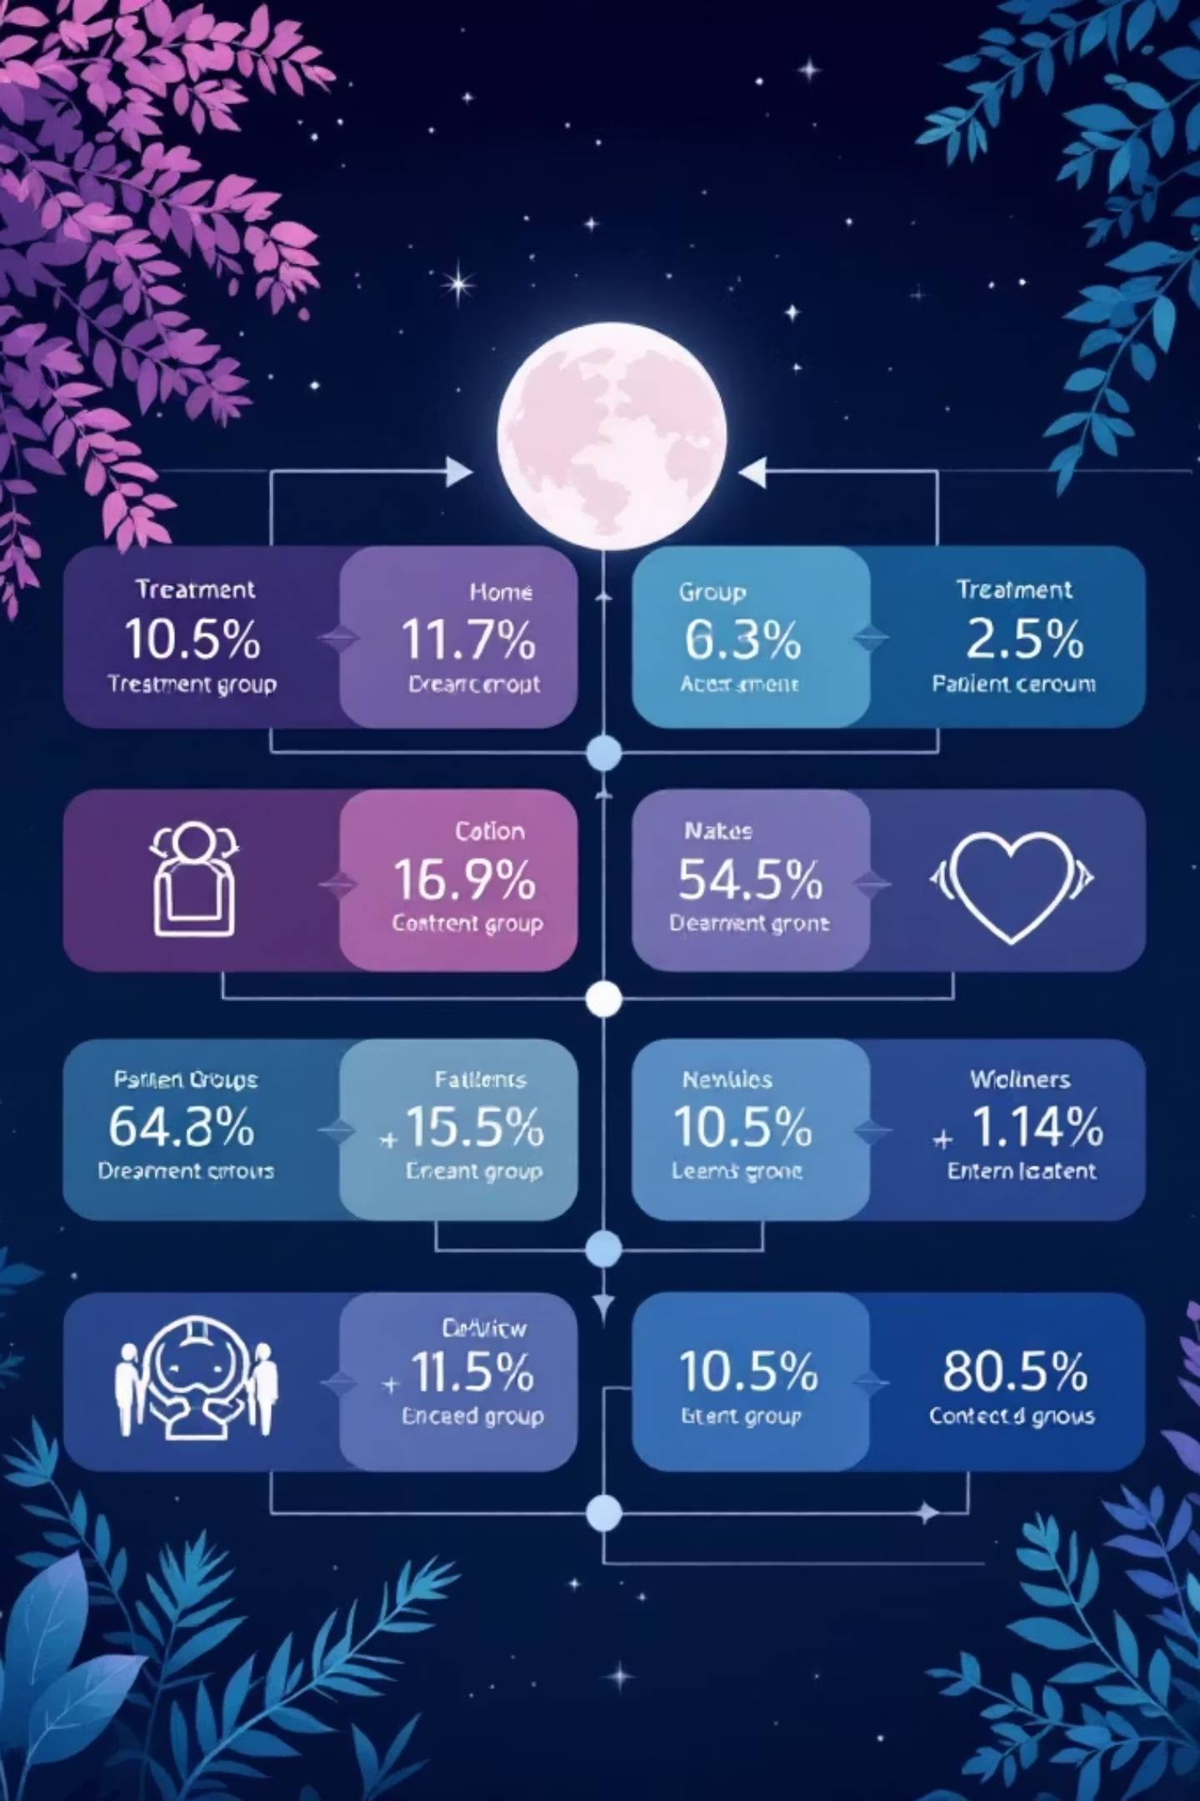
Understanding the Basic Concept
01
02
Categorical Variable (Factor)
Quantitative Variable (Response)
The grouping variable with different levels or categories (e.g., Treatment A, Treatment B, Placebo)
The measurement being compared across all groups (e.g., patient recovery time, test scores, sales figures)
03
Group Comparison
ANOVA examines whether the group means differ significantly while accounting for within-group variability

Slide 5
Hypotheses in ANOVA
Null Hypothesis (H₀)
Alternative Hypothesis (Hₐ)
All group means are equal
At least one group mean is different
There is no significant difference between the means of the groups being compared. Any observed differences are due to random chance or sampling variability.
There is a significant difference between at least one pair of group means. The treatment or factor has a measurable effect.
Example: μ₁ = μ₂ = μ₃
Example: Not all μ are equal

Slide 6



How ANOVA Works: The F-Statistic
Within-Group Variation
Between-Group Variation
Measures how much individual values vary within each group. Smaller variation means more reliable group estimates.
Measures how different the group means are from the overall grand mean. Larger differences suggest treatment effects.
The F-statistic = (Between-group variation) / (Within-group variation). A large F-value indicates significant differences between groups relative to within-group variability.

Slide 7
Assumptions of ANOVA
For ANOVA results to be valid, three key assumptions must be met:
1. Normality
2. Equal Variance (Homogeneity)
3. Independence
Each group's data should be approximately normally distributed. This ensures the F-statistic follows the expected distribution.
Observations must be independent of each other. This means one participant's data doesn't influence another's.
All groups should have similar variances. This means the spread of data points should be roughly the same across all groups.

Slide 8



Real-World Applications of ANOVA
Healthcare & Medicine
Business & Marketing
Agriculture & Science
Testing effectiveness of different drug treatments, comparing recovery times across therapies, or evaluating surgical techniques
Comparing sales performance across regions, testing different advertising campaigns, or evaluating customer satisfaction by product line
Evaluating crop yields with different fertilizers, comparing growth rates under various conditions, or testing environmental interventions

Slide 9

Key Takeaways
Efficient Comparison
ANOVA allows testing multiple groups simultaneously without inflating Type I error rates from multiple t-tests
Variation Analysis
It separates total variation into between-group and within-group components to identify meaningful differences
Wide Applicability
Used across research, business, healthcare, and education to make data-driven decisions about treatments and interventions

Slide 10

Thank You!
Understanding ANOVA opens doors to advanced statistical analysis and research methodology.
Questions?
Let's discuss any concepts you'd like to explore further
Next Steps
Practice with real datasets and consider post-hoc tests for detailed comparisons
ANOVA: Your tool for comparing multiple group means with confidence

